Slide 1
Food Ordering System
Presented BY
RAJAT BHARTI (181500545)
Vijay Pratap (181500788)
Vishal Tyagi (181500810)

Slide 2
CONTENTS
Introduction
History
Basic structure
Basic Concept Used
Working
Features
Available Applications
User Interface
Advantages and Disadvantages
Conclusions

Slide 3
Introduction
The online food ordering system sets up a food menu online and customers can easily place the order as per they like. Also with a food menu, online customers can easily track the orders. The management maintains customers database, and improve food delivery service. The Restaurant management systems motivates us to develop the system. There are various facilities provided so that the users of the system will get service effectively. Also, the system considers Restaurants as well as Mess facility to the customers.

Slide 4
History
The first online food order was a pizza from Pizza Hut in 1994.
This is a picture from a 2018 Pizza Hut pizza box, which describes the first online food sale.
The online food ordering market has increased in the U.S with 40 percent of U.S adults having ordered their food online once.[3] The online food ordering market includes foods prepared by restaurants, prepared by independent people, and groceries being ordered online and then picked up or delivered.
The first online food ordering service, World Wide Waiter (now known as Waiter.com), was founded in 1995.[7] The site originally serviced only northern California, later expanding to several additional cities in the United States.

Slide 5
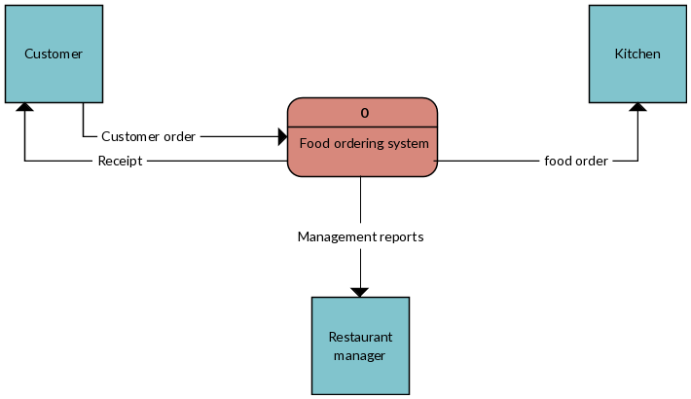
Basic structure

Slide 6
Basic concepts used
Online food ordering is a process of ordering food from a local restaurant or food cooperative through a web page or app. A customer will search for a favorite restaurant, usually filtered via type of cuisine and choose from available items, and choose delivery or pick-up.

Slide 7
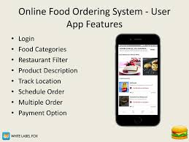
Features
Take Away Ordering. The take away ordering is a win-win solution for restaurant owners and customers.
Pre-Orders
Catering Orders
Scan & Order
Unique Webpage
Social Media Sharing
Search Engine Optimization
Combo Deals

Slide 8
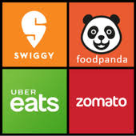
Available Applications
Foodpanda
Zomato
Faasos
Deliveroo
Dunzo
Grubhub
Swiggy

Slide 9
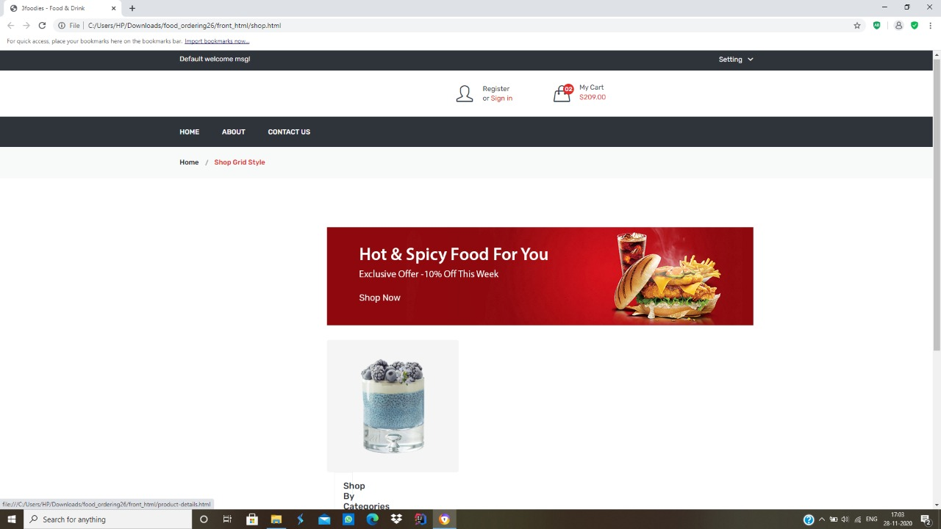
User Interface

Slide 10
Advantages
Makes ordering process easier
Efficient costomer ordering management
No cost marketing.
Better customer data
Convience of mobile ordering
Greater reach

Slide 11
Disadvantages
Deliverymen put themselves in danger
Disguised increased expense
Juggling with your health
Unsuccessful payment resulting in delayed food delivery

Slide 12
Conclusions
With online food ordering system, a restaurant and mess menu online can be set up and the customers can easily place order. Also with a food menu online, tracking the orders is done easily, it maintain customer's database and improve the food delivery service.

Slide 13
THANK YOU

